Slide 1
Software crisis 2000+

Slide 2
Software failures 2015/2016
Nest thermostat leaves users in the cold
600,000 RBS payments go missing
US Airforce F-15
Problems with software left pilot radar blind
400 Billion USD
8 million lines
“the rate of deficiency correction has not kept pace with the discovery rate” (DoD)

Slide 3
From year 2000
In 1972, an IBM 360 could cost $1.5 million dollars, its maximum memory capacity was 8MB, the laptop for this lecture has a total of 16 Gigabytes
Computers are everywhere and connected
So given this power why can computers not solve any problem?
Many problems not clearly understood computationally
Many problems scale badly
New computer hardware/config needs new software methods (e.g. neural-net, quantum computers, grid computing) .. non Von-Neumann architecture
Notes:
This side of the millennium what is different in computing, and what is different in software engineering?
The most important thing, without doubt, is the cost of the products.
In 1972 the Michigan Terminal System was implemented on an IBM model 360/68 that cost about £1.5 million, of which £60K was for the building modifications and water cooling system.[Accidental tasks included handling fungus in the cooling pipes – bugs indeed!].
Now for about £1,000 I have about the same processing power and about the same disk space on this laptop. The key difference is that only I use the laptop whereas the 360 had about 250 simultaneous users at any time 24 hours a day, 7 days a week. It also had access to gigabytes of tape storage – though it needed a team of about 7 computer operators to keep it fed, watered, milked, serviced and taped.
The second change has come about because of the first. Computers are now everywhere. These are essentially still “computers”, but soon the computer will vanish into your telephone, car, television, radio, clothes, container, under your pet’s skin, and probably into a small cavity in your skull.
A part of this change, and probably inseparable from it, is that many of these computers are connected. The connections are by wire or some part of the electro-magnetic spectrum: e.g. radio, microwaves, infra-red, sound, and laser light.
The software has changed too.

Slide 4
New domains
Architecture
Building design packages
Medical
Expert diagnostic help (AI)
Simulation (heart disease)
Law
Contract analysis and case law database (AI, clustering)
Electronics
Simulation
DNA analysis
Clustering and big data analysis

Slide 5
AI and machine learning
It is very possible to train a NN without having any clear understanding of how it works
Neural networks are highly complex, if a network fails, for example classifies a picture of a cat as a dog, this cannot be isolated to a given instruction (as a software bug can)
A neural network can fail a particular test case but still be useable, the test cases are highly unrestricted in scope (e.g. any picture)

Slide 6
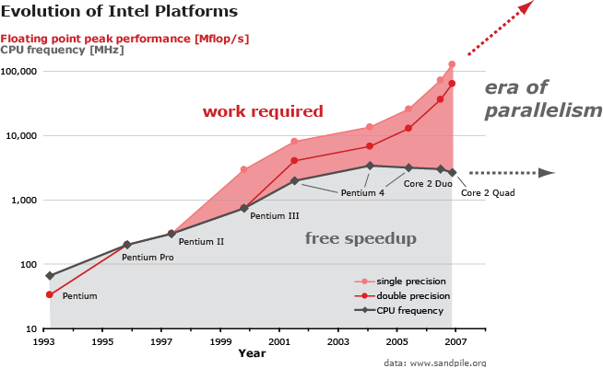
Moore’s law and parallelism
Spiral project
cmu.edu
Notes:
We can see that processor clock speed for current silicon technologies is hitting a wall in terms of “free” speed up of software execution.
New processors rely on using multi-core technology to improve performance.
Unless the software has been optimised for running in parallel then no performance increase will be achieved, by adding more processors.

Slide 7
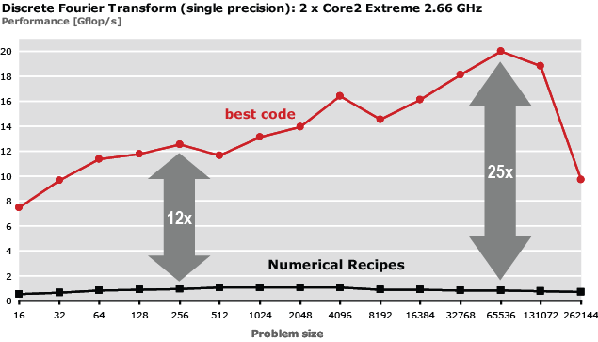
Performance Challenges of modern software
Notes:
We can see how the larger the problem size is (in terms of processed data) the larger the difference between non-optimised and optimised code is.
These figures are from the Spiral project at Caregia Mellon University.
www.spiral.net.
Their core research question is “Can we teach computers to write fast libraries?”

Slide 8
Parallelism simple example
int addElements(int data[]) {
for (int i=0;i<array.length;i++) {
sum=sum+data[i];
}
}
However many processors are used, its not obvious how this code’s speed will be increased.

Slide 9
Parallism simple example (threaded)
class Adder extends Thread { int sum=0;
int index1=0,index2=0;
public Adder(int data[], int index1,int index2) {
this.data=data; this.index1=index1;
this.index2=index2;
}
int addElements() { sum=0;
for (int i=index1;i<index2;i++) {
sum=sum+data[i];
}
return(sum);
} int getSum() {
return(sum);
}
public void run() {
addElements();
} }

Slide 10
Parallism simple example (threaded)
int addElements(int data[]) {
Adder adder1=new Adder(data,0,data.length/2);
Adder adder2=new Adder(data,data.length/2+1,data.length);
adder1.start();
adder2.start();
adder1.join();
adder2.join();
return(adder1.getSum()+adder2.getSum());
}
Notes:
We can see that the amount of code and the code complexity has to be increased considerably to make use of more than 1 processor. To optimise the code further it needs to be able to handle more than 2 processors. Image doing the same optimization with a sort routine, what kind of sort algorithm would work well?

Slide 11
Spiral Project www.spiral.net
Computers used to generate code for multi-core architecture, which then performs functions such as Fast Fourier Transform
www.spiral.net/codegenerator.html
Spiral also produces software to automatically designs hardware cores
By automating hardware/software implementations accidental complexity can be factored out of design

Slide 12
What is different now?
Software is developed to be sold shrink wrapped
Users develop niche products not systems
Simple business applications have vanished to be done with standard packages
Many product include AI as an integral component
Skills in data science and machine learning are becoming central
Notes:
Software is now boxed and shrink wrapped or delivered automatically through some connection method. (Does everyone know how to use zip/unzip, etc?)
The users have changed too. They are everywhere not just behind business work-desks. Their requirements are for general tools, to be sure, but increasingly for niche products: computer games, genealogy software, finite element packages, music and image manipulation, DNA pattern search tools, etc. In each of these areas several producers exist – and where necessary the user can write the niche stuff himself using both general tools and niche targeted tools.
However, the main difference is that the main driver for application development is no longer business it is the home and niche markets. Much of what business does can be achieved with general tools, indeed the general tools which now exist: the word processor, spreadsheet, database were originally business specific tools.

Slide 13
What remains the same
Centrality of the gifted programmer concentrating on the conceptual integrity of the system
The difficult bit is still the conceptual design
The constraints (the box defined by resources)
Notes:
But what is new and different comes because of new products.
The software engineering process, as predicted by NSB, has not changed significantly. The key agent is still the talented programmer concentrating on the “conceptual integrity” of the product. There are just many more of them out there and not all of them have been snapped up by Microsoft or Oracle.
The programmer is still battling with the same creative tasks and accidental problems and still having problems with his conceptual design.
However, in some niche areas think say of games production, a multitude of tools and techniques have evolved that aim to ensure that a “new” product, say a Harry Potter game, can be brought to market in about 3-9 months.
Development constraints and deployment constraints still remain although the numbers (e.g. of memory available to do the development or in the target computer, might increase

Slide 14
Software Engineer roles
Used to be broken up
System Analyst (sales)
Database designer
Programmer
Tester
Now commonly all 1 role
SQL, web software developer
Tester and analyst

Slide 15
Software Engineering 2016+
Most software now also on mobile devices
Fragmentation of platforms (need for portability)
iPhone
Windows
Android
Blackberry
Connectivity now broad and narrowband and wireless
Notes:
It is common now for software to require porting to mobile devices. This has particular challenges, in terms of platform fragmentation and therefore porting between platforms. Network connectivity for mobile applications is wireless, this is power hungry and often unreliable. Software has to be optimised for this unreliable network service.

Slide 16
Mobile development
Fragmentation
Want 1 code base, many platforms
Example PhoneGap/Cordova
Development in Javascript
APIs connect mobile API to Javascript
Diversity of mobile web development
Issues with connectivity
Battery life should ideally be conservered

Slide 17
Current challenges
Ubiquitous computing
Intelligent sensing: voice, vision, touch
Massive connectivity
Super scalability
Critical systems
Secure systems
Configuration modelling
Notes:
Ubiquitous computing – is defined as being “computing everywhere” . Perhaps the most exciting being the idea of wearable computers, in the very fabric of your clothes.
Intelligent sensing and processing, especially to process voice (e.g. voice interfaces), vision (I.e. computers that can see), and devices that relay touch to and from users (haptic devices).
Massive connectivity achieved by using all forms of communication and then using the connectivity and spare processing capacity to solve inherently difficult problems (includes grid computing).
Critical systems and dependable software. This is one of the key areas for software engineering. All the skills: fault avoidance, fault detection and recovery, and fault tolerance computing are required and are currently research issues. Examples are: power system monitoring, medical systems, telecommunication switches, aircraft auto-piloting.
Secure systems include banking and finance systems that should be impervious to accidental and malicious damage. These systems are often also critical systems.
Configuration modelling is the area that configures equipment and services to meet spec0ific criteria. Used in, e.g. telecommunications, to configure systems based on information such as equipment availability, usage traffic, cost, and services required.

Slide 18
Ubiquitous computing and intelligent sensing
Computing implemented everywhere
Technologies such as
Plastic transistor technology
Wearable computers
Intelligent sensing
Ability of systems to see/hear understand their environment
Haptic feedback, advanced interfaces
Sense substitution technologies. e.g. seeing through your tongue

Slide 19

Scaling up
Scale up
Increase process/memory speed etc.
Benefits
Simple software architecture
Problems
Cost per increase
Limitations of scalability
Hardware failure leads to total loss of node

Slide 20
Scaling
Scale out
Benefits
Cheap, easier to have failsafe, can be geographically separated
Issues
Software engineering has to be more complex

Slide 21
Massive scalability and connectivity
Allows for the implementation of grid computing
Loosely coupled, heterogeneous, geographically dispersed
Issues of trust, (node to cluster level and vice-versa)
Differences of OS, language, capacity
Rationing of capacity between grid task and local tasks
Loss of network or loss of node (power off)
Super scalability
Cloud computing
Scaling transparency
Modelling co-current systems
Actor model

Slide 22
Critical and secure systems
Safety critical
Highly structured design/development methodology: limiting function/method length, restricting scope, limit on pointer dereferencing
Fail safe system design (limit checking driver code.. think of Ariane), clear modular decomposition/ responsibilities
Self healing systems, fault tolerant systems
Secure systems
Utilizing latest encryption and signature technolgies
Hardware/software advances such as biometrics
Again many advances and experiences, see http://www.sans.org/top25-software-errors

Slide 23
Summary
New domains
More complex software
Massive degree of independency
More parallel architectures
Greater security threats

